Slide 2
A₂A₁A₀
Y₆Y₅Y₄Y₃Y₂Y₁Y₀
Y₆
0 0 0 0 0 0 0 0 0 0
0 0 1 0 0 0 0 0 0 1
0 1 0 0 0 0 0 0 1 1
0 1 1 0 0 0 0 1 1 1
1 0 0 0 0 0 1 1 1 1
1 0 1 0 0 1 1 1 1 1
1 1 0 0 1 1 1 1 1 1
1 1 1 1 1 1 1 1 1 1
A₂
Y₅
Y₄
A₁
Y₃
Y₂
Y₁
A₀
Y₀

Slide 3
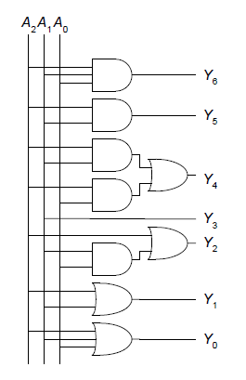
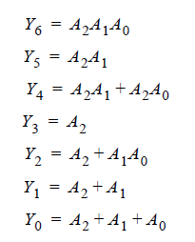
Soluzione 2.38

Slide 4
Logic using Multiplexers
Using mux as a lookup table

Slide 5
Logic using Multiplexers
Reducing the size of the mux

Slide 6
Teorema di shannon
Data una funzione booleana f di n variabili vale l'uguaglianza:
possiamo utilizzare questo teorema per realizzare una funzione di n variabili usando un MUX e 2 funzioni da n-1 variabili

Slide 7
Es. sintesi con mux
Si progetti un circuito che realizza la funzione descritta dalla tabella della verità utilizzando MUX a 2 ingressi come componenti elementari

Slide 8
Es. sintesi con mux
A₀
0
0
0
1
0
0
1
0
A₁
A₂
D
A₁

Slide 9
Es. sintesi con mux
A₁
0
A₂
A₀
D
A₁
0
A₀

Slide 10
Decoders
N inputs, 2^{N} outputs
One-hot outputs: only one output HIGH at once

Slide 11
Decoder Implementation

Slide 12
Logic Using Decoders
OR minterms

Slide 13
Timing
Delay: time between input change and output changing
How to build fast circuits?

Slide 14
Propagation & Contamination Delay
Propagation delay: t_{pd} = max delay from input to output
Contamination delay: t_{cd} = min delay from input to output

Slide 15
Propagation & Contamination Delay
Delay is caused by
Capacitance and resistance in a circuit
Speed of light limitation
Reasons why t_{pd} and t_{cd} may be different:
Different rising and falling delays
Multiple inputs and outputs, some of which are faster than others (see next slide)
Circuits slow down when hot and speed up when cold

Slide 16
Critical (Long) & Short Paths
Critical (Long) Path: t_{pd} = 2t_{pd_AND} + t_{pd_OR}
Short Path: t_{cd} = t_{cd_AND}

